Slide 1

Project 3: Visualizing Data

Slide 2


our Journey
This project was driven by a common love of every member in this group and that was a love for traveling.
This prompted us to create a dashboard that would allow a user to search an area, select one of the five categories, and be presented with the top ten of the selected category as well as the Yelp review.
This would assist a person when determining where to travel based on these five categories.

Slide 3





Data Collection
To begin our journey,

Slide 4

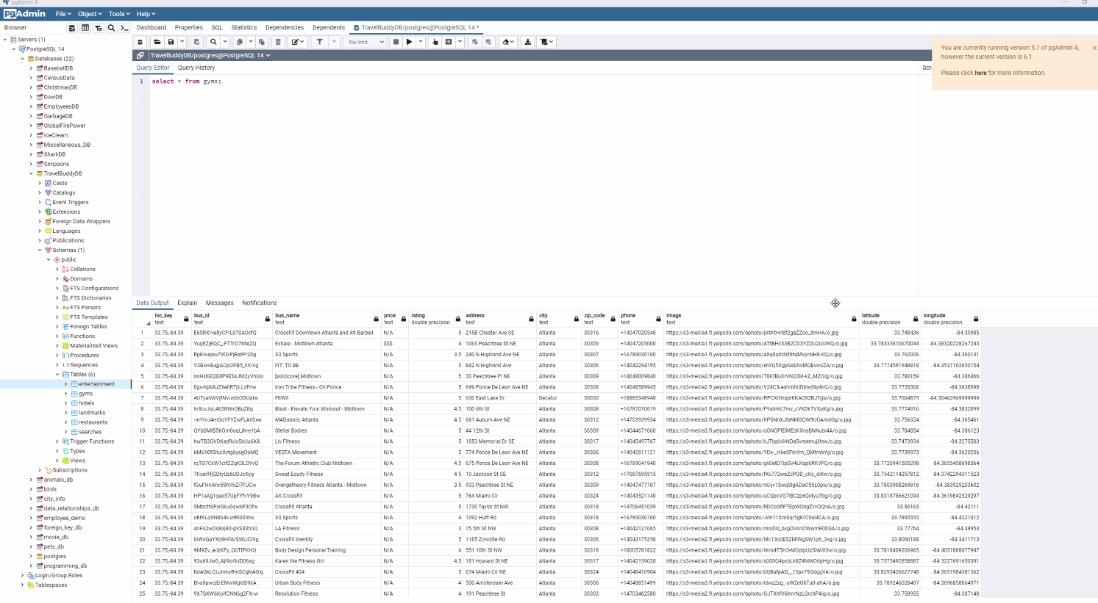
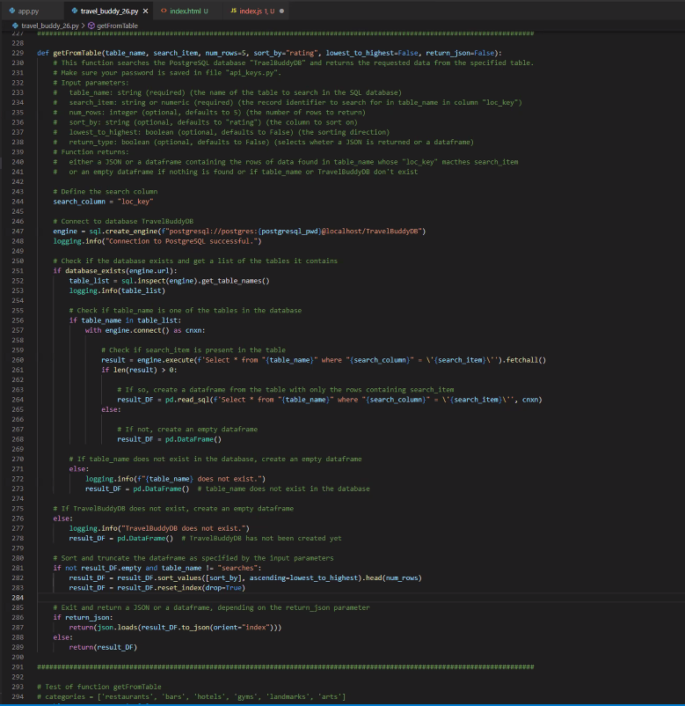
Data Cleaning
Rounded latitude and longitude (preventing new entries for locations in close proximity)
Added error code for locations not found
Included code to find missing price information
Python code to retrieve data from SQL database. Only the top 10 highest rated places are returned.

Slide 5
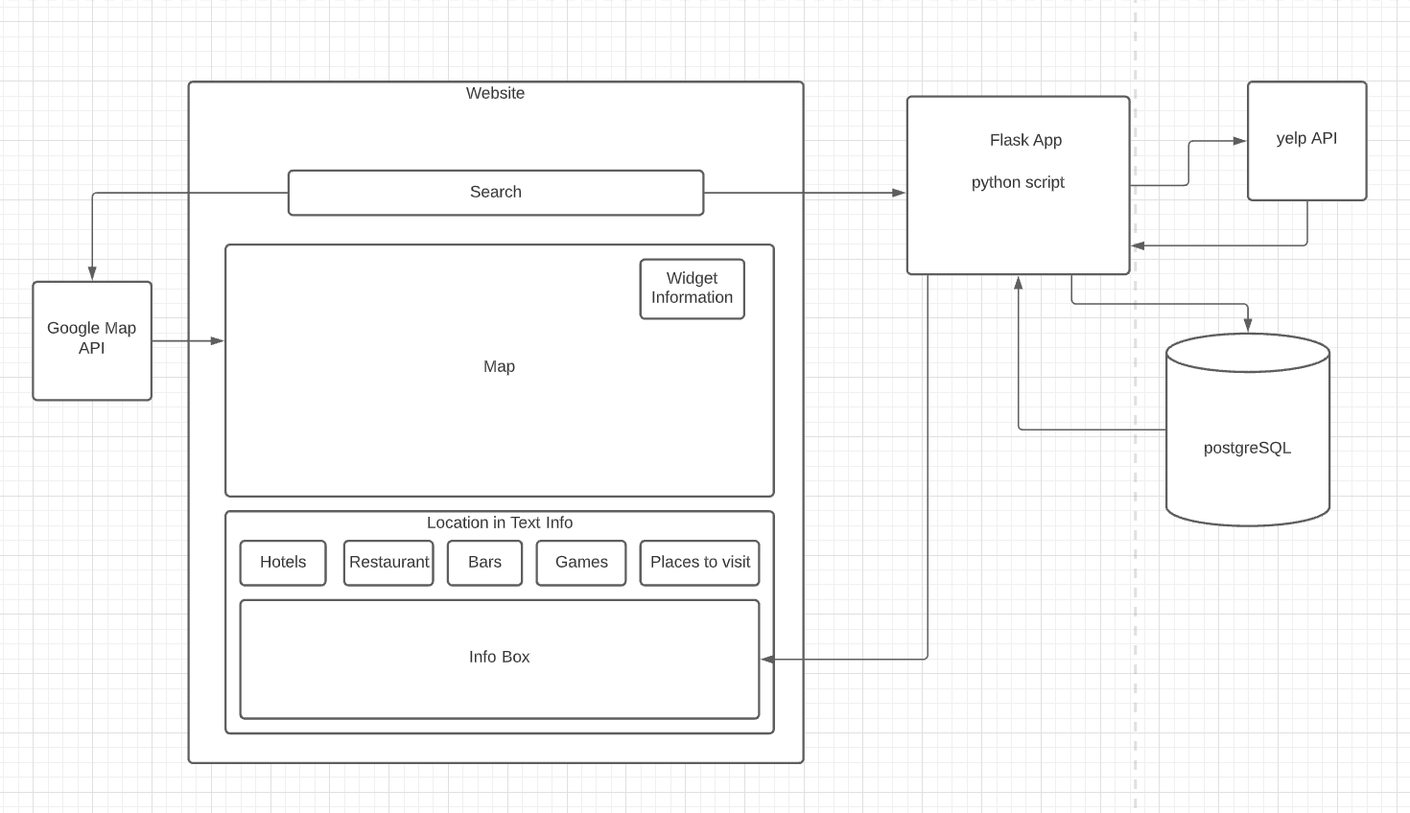
Architecture
Notes:
Travel Buddy is designed to take real time user data to produce results, whether we have the data on hand or not.
Once a user submits their request, 2 things will occur.
First, The Google Map will automatically update the location to show the user a broad overview of the area they searched for.
Second, this entry will be sent to flask, where the real magic happens.
The flask app will take whatever location was entered into the search bar, be it a zip code, city, or landmark/business name, and convert it to coordinates.
These coordinates will first be checked against our database.
If the data exists it will be sent back to flask, then back to the user.
If the data does not exist, flask will then send the coordinates to the Yelpfusion! API, collect the data, enter it into the database, then return it to the user via flask.
Ideally this data would be cached for a certain amount of time, and replaced once that amount of time has passed, and the coordinates are searched for again.

Slide 6

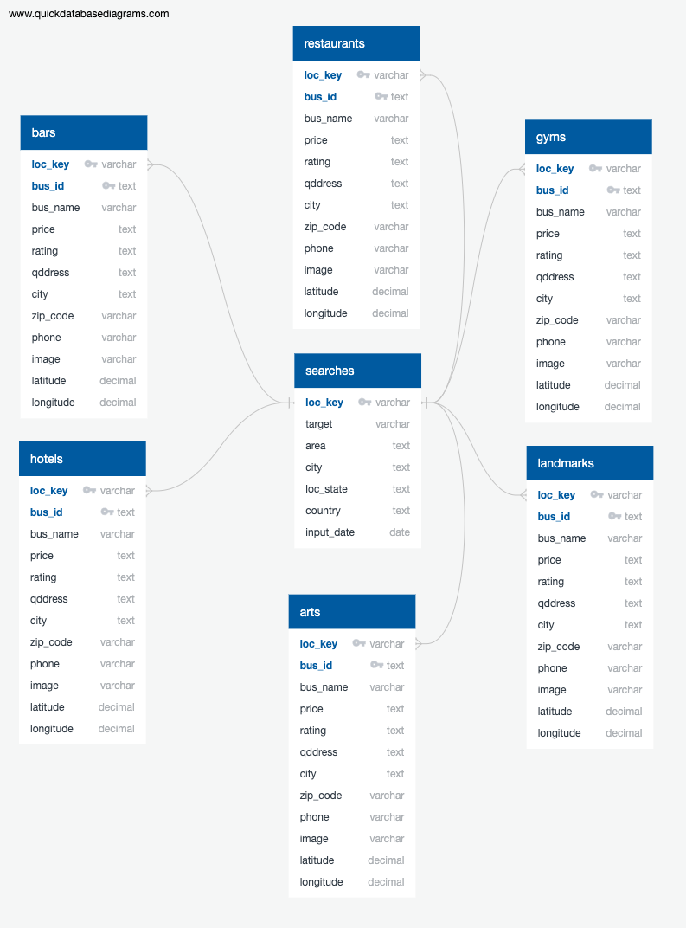

Database
Notes:
The database is set up to allow for cascading logic. The searches table is set up with latitude, longitude pairs as the Primary Key called loc_key, which also serves as the foreign key for all tables populated with data received from YelpFusion! With a one to many relationship.
This allows for two things.
When the flask app checks the database, it only needs to search only one table for the key. This can be done after the Google API is queried, but before the Yelp API.
When the date check is implemented, If the data is determined to be old and in need of refreshing, only one entry needs to be deleted. (The loc_key in the searches table)

Slide 7
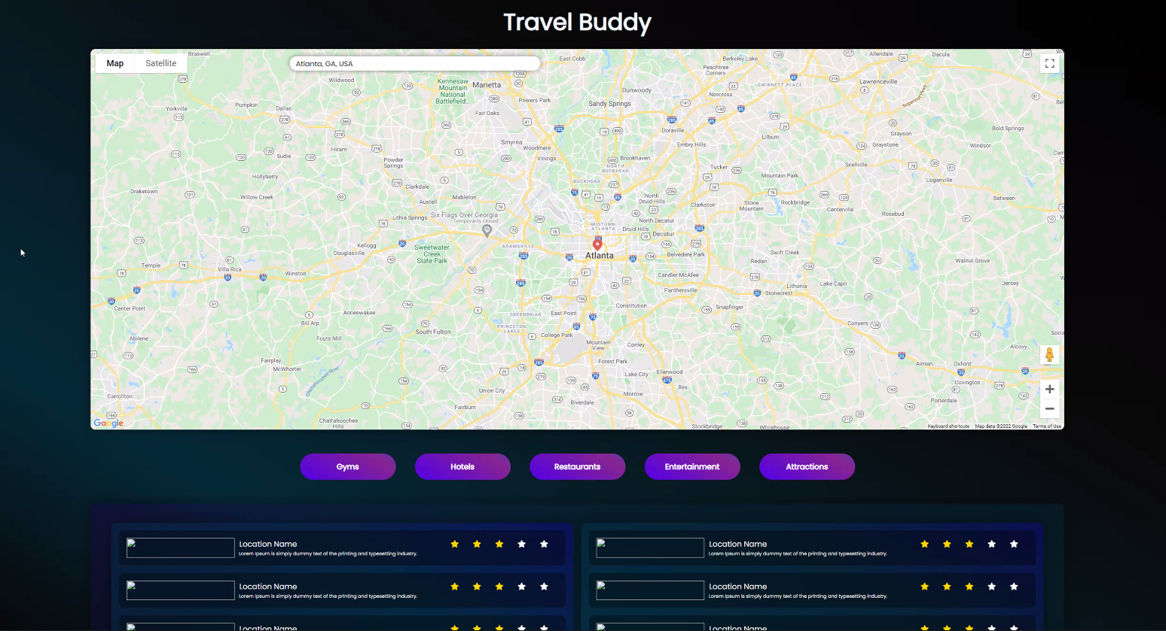
This visual shows a location input in the search field.
(Notice: There is no information displayed below, due to no button being selected.)

Slide 8
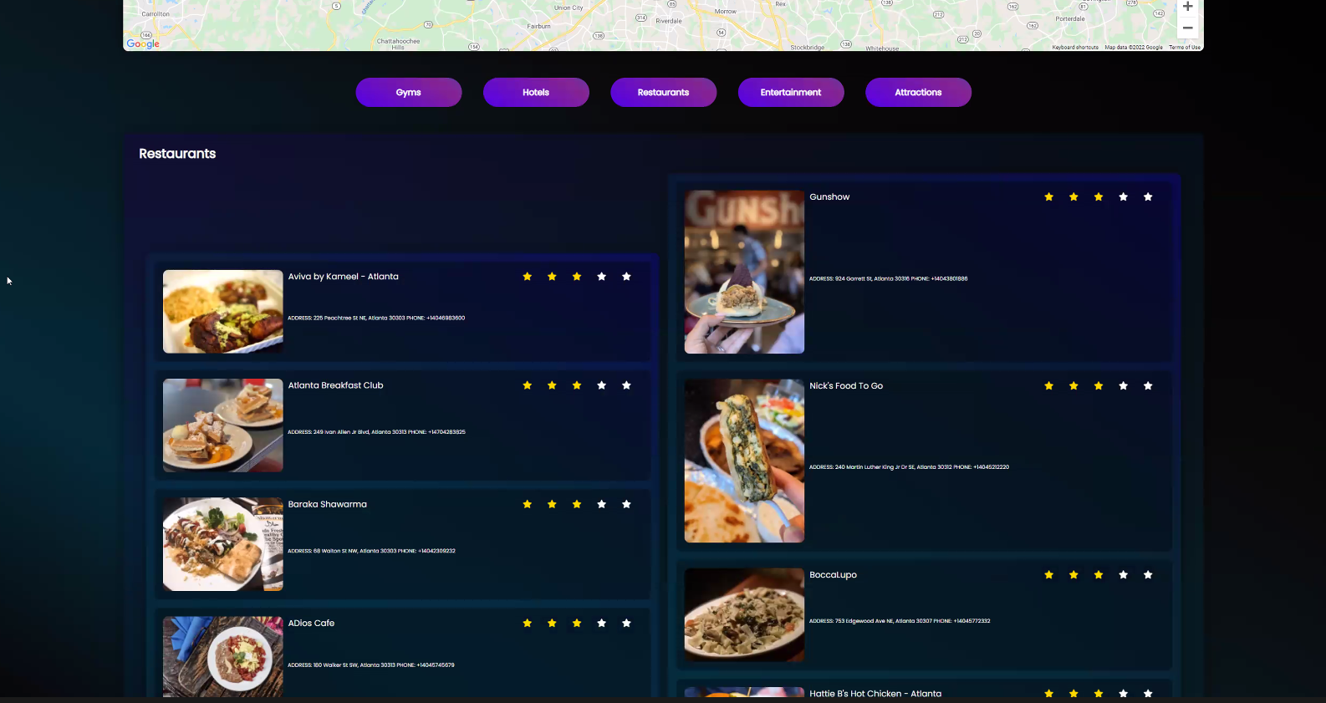
This visual shows an output of the top 10 restaurants and their physical location once the location is entered in the search field and the restaurant button is selected

Slide 9
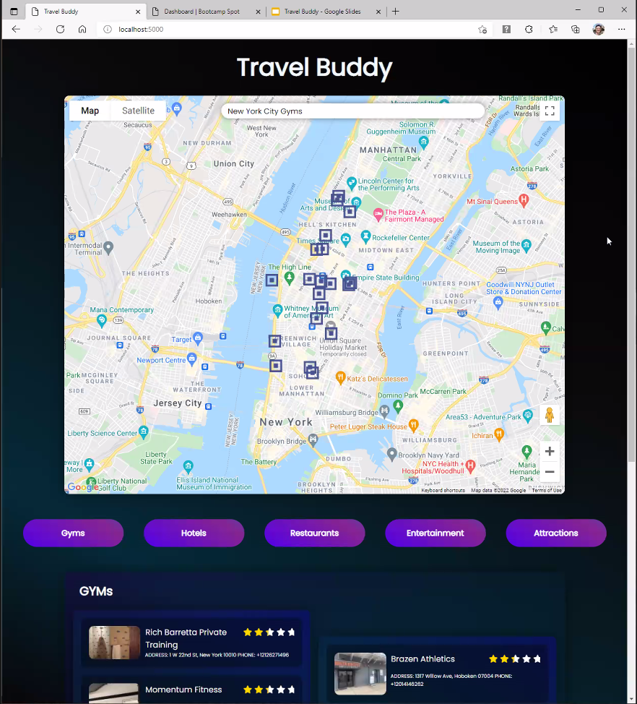
Here a location and category was placed in the search field. Where google API’s can show that result of gyms or anything else according to the request being sent through the search bar.

Slide 10
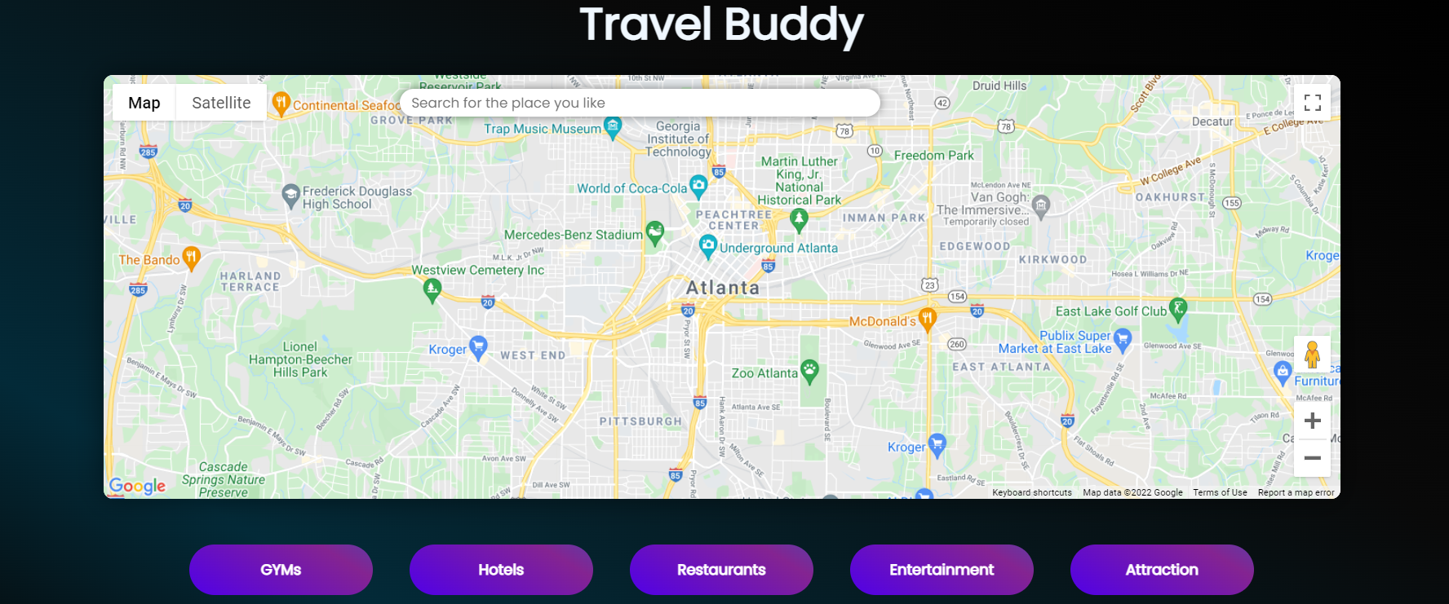
Let’s Explore!
http://127.0.0.1:5000/

Slide 11
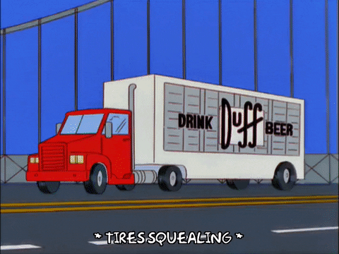
Our Roadblocks
Original project was scrapped due to data unavailability.
We experienced issues with getting python and java to interact with each other.
Yelp did not offer a standard number of data fields. If data was not available, it was simply not returned. We had to find a way around this as it would cause array size issues.
Because of the previous listed issues, time became a factor and we did not have time to implement Heroku as desired.

Slide 12



Future Considerations
Date Check
We would eventually like for data to be cached temporarily, with data over a week old being flushed, and replaced via a new API call.
Schema for DB
Adding Primary and Foreign keys to allow for CASCADING deletes of data to support the Date Check.
Leaflet vs Google Maps
The Google Maps widget appears to cause issues to work around due to its built in functionality. We would like to explore if it is the best map tool to produce our vision.
Visual Star Representation
Fix star representation to include data pulled from API.

Slide 13

THIS CONCLUDES OUR PRESENTATION

